Slide 1

North South University
CSE 445.2
Fall 2020
Group- 8
Project Presentation
Topic: BigMart Sales Prediction
Submitted to: Syed Athar Bin Amir
Group Details
Name | ID
Meherab Mamun Ratul | 1711786642
Md Sharif Hossain | 1712336642
Faijul Abedin | 1711316642

Slide 2
Background and History
The data scientists at BigMart have collected sales data for 1559 products across 10 stores in different cities.
Certain attributes of each product and store have been defined.
The aim is to build a predictive model and find out the sales of each product at a particular store.
Using this model, BigMart will try to understand the properties of products and stores which play a key role in increasing sales.

Slide 3
Hypothesis Generation
Hypothesis Generation was done before seeing the data or else we would end up with biased hypotheses. Following are some of the hypotheses based on the problem statement.
- Sales are higher during weekends.
- Higher sales during morning and late evening.
- Higher sales during end of the year.
- Store size affects the sales.
- Location of the store affects the sales.
- Items with more shelf space sell more.

Slide 4
The Data
We have train (8523) and test (5681) data set, train data set has both input and output variable(s). You need to predict the sales for test data set.
Dataset Source Link:
https://www.kaggle.com/devashish0507/big-mart-sales-prediction

Slide 5
Variable & Description
Item_Identifier | Unique product ID
Item_Weight | Weight of product
Item_Fat_Content | Whether the product is low fat or not
Item_Visibility | The % of total display area of all products in a store allocated to the particular product
Item_Type | The category to which the product belongs
Item_MRP | Maximum Retail Price (list price) of the product
Outlet_Identifier | Unique store ID

Slide 6
Variable & Description (continued)
Outlet_Establishment_Year | The year in which store was established
Outlet_Size | The size of the store in terms of ground area covered
Outlet_Location_Type | The type of city in which the store is located
Outlet_Type | Whether the outlet is just a grocery store or some sort of supermarket
Item_Outlet_Sales | Sales of the product in the particulat store. This is the outcome variable to be predicted.

Slide 7
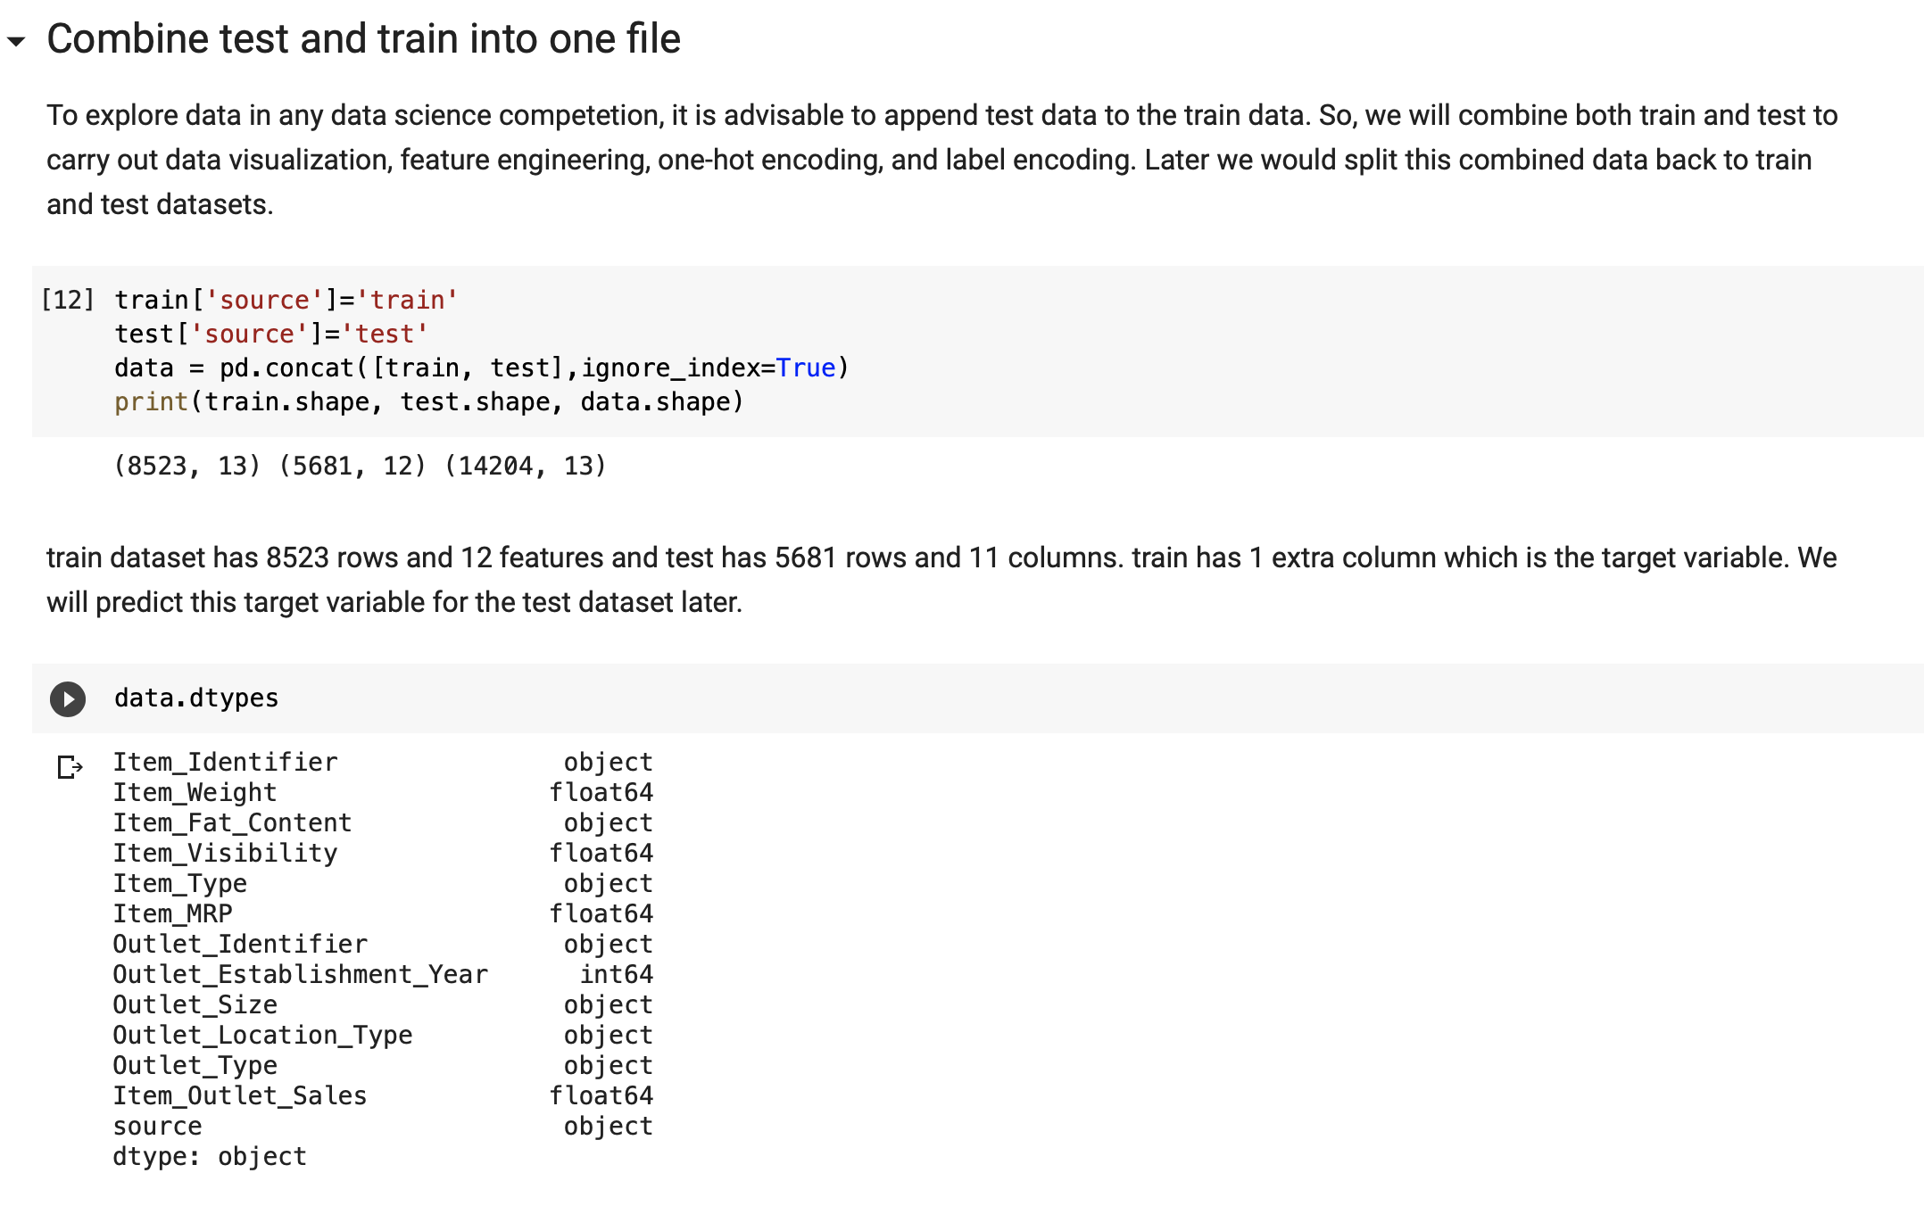
Dataset Processing:

Slide 8
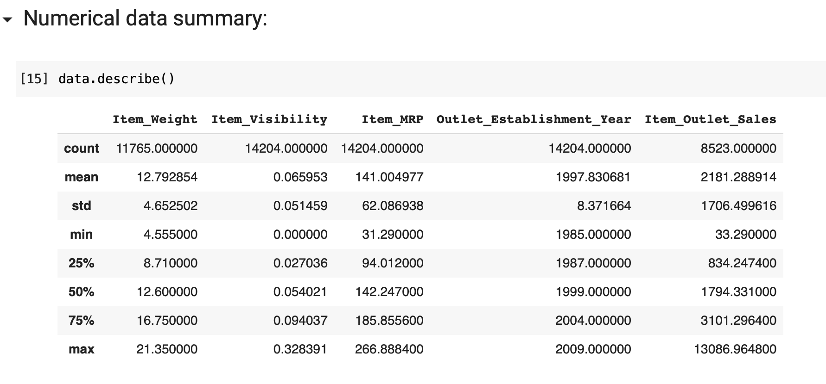
Dataset Processing:

Slide 9
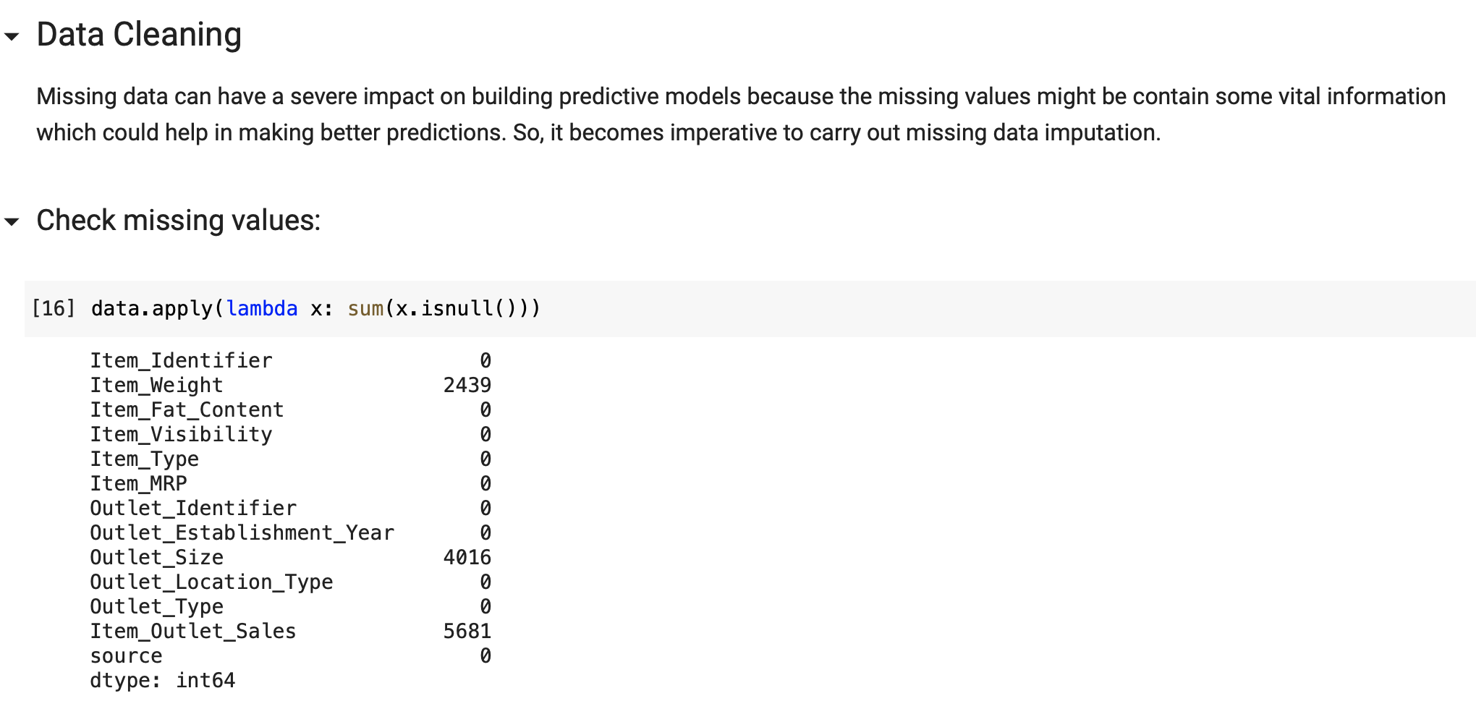
Data Cleaning:

Slide 10
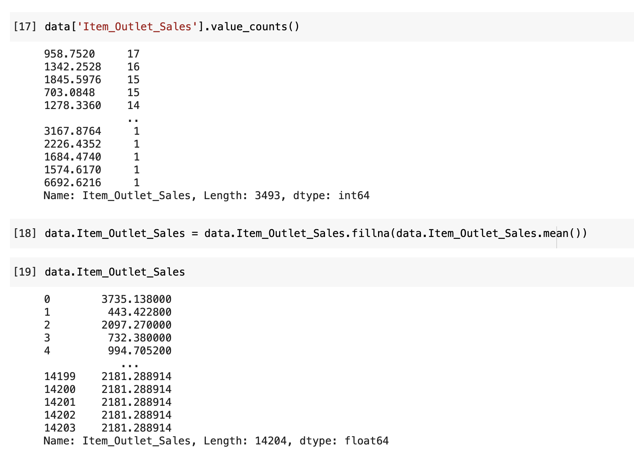
Data Modifying:
Same way: Item_Weight & Outlet_Size have been filled.

Slide 11
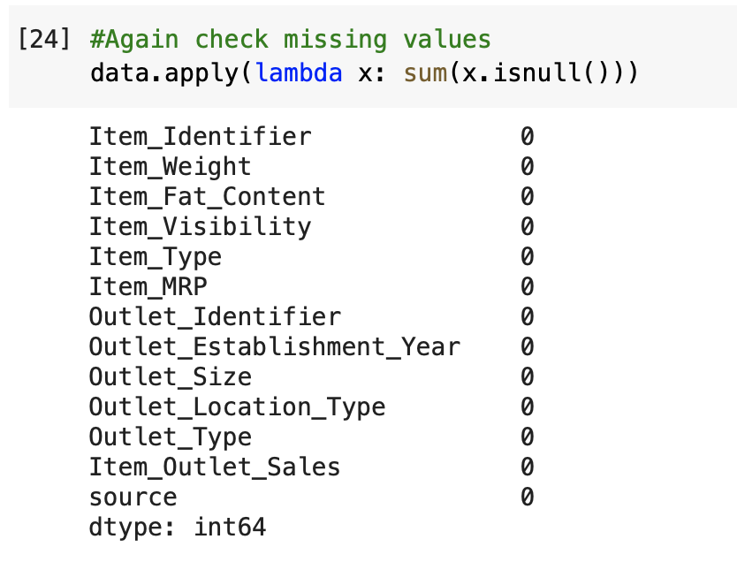
Data Re-Checking:

Slide 12
Data Re-Checking:

Slide 13
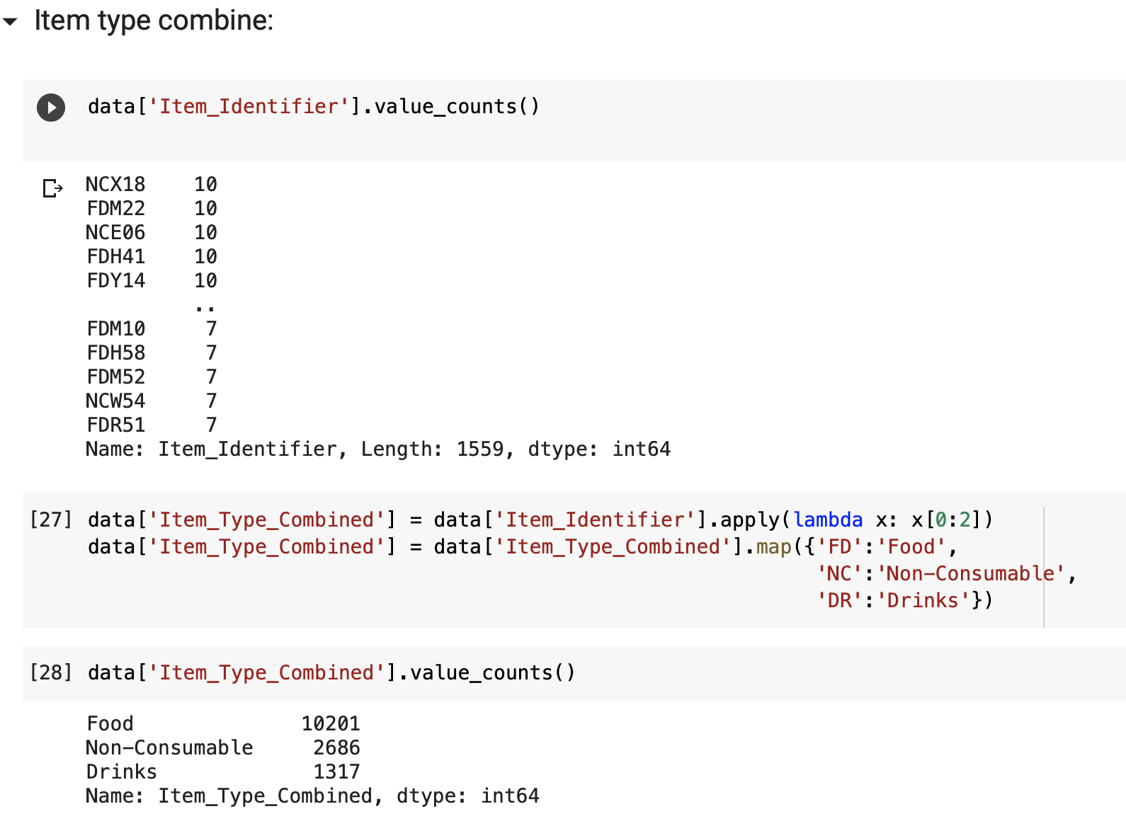
Combining Item Types:

Slide 14
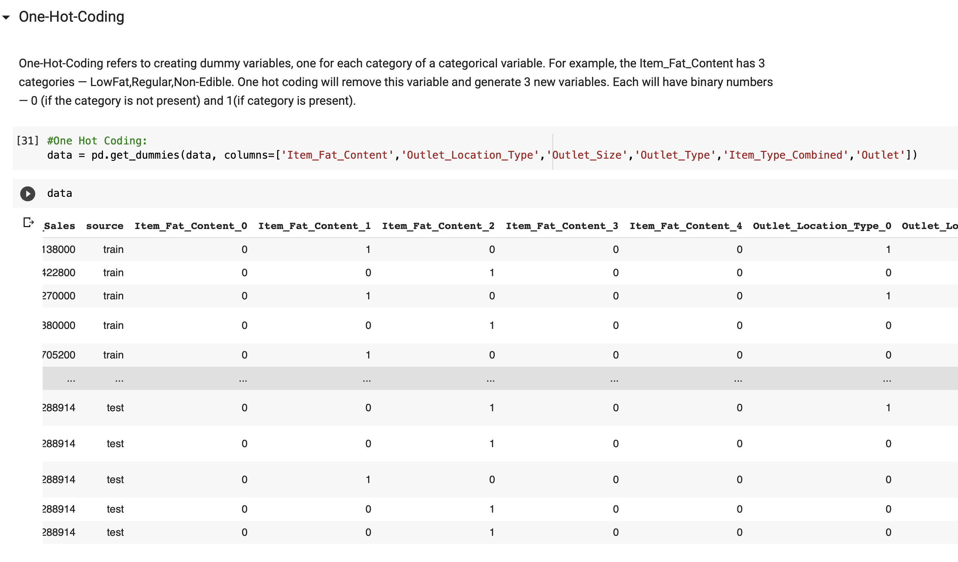
Implementing One-Hot Encoding:

Slide 15
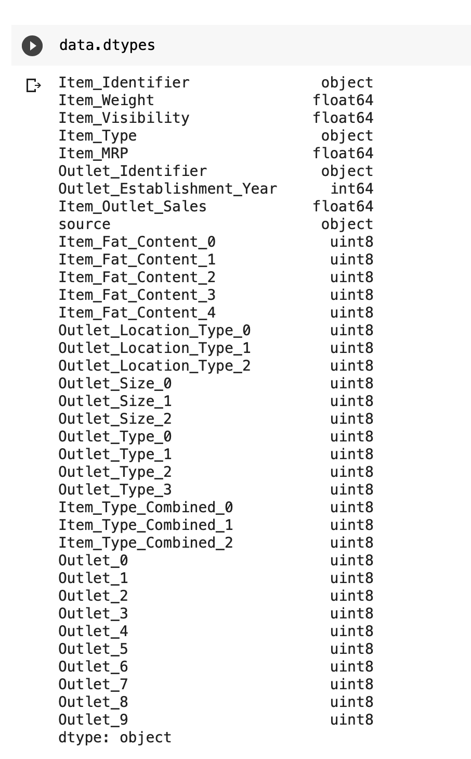
Implementing One-Hot Encoding:

Slide 16
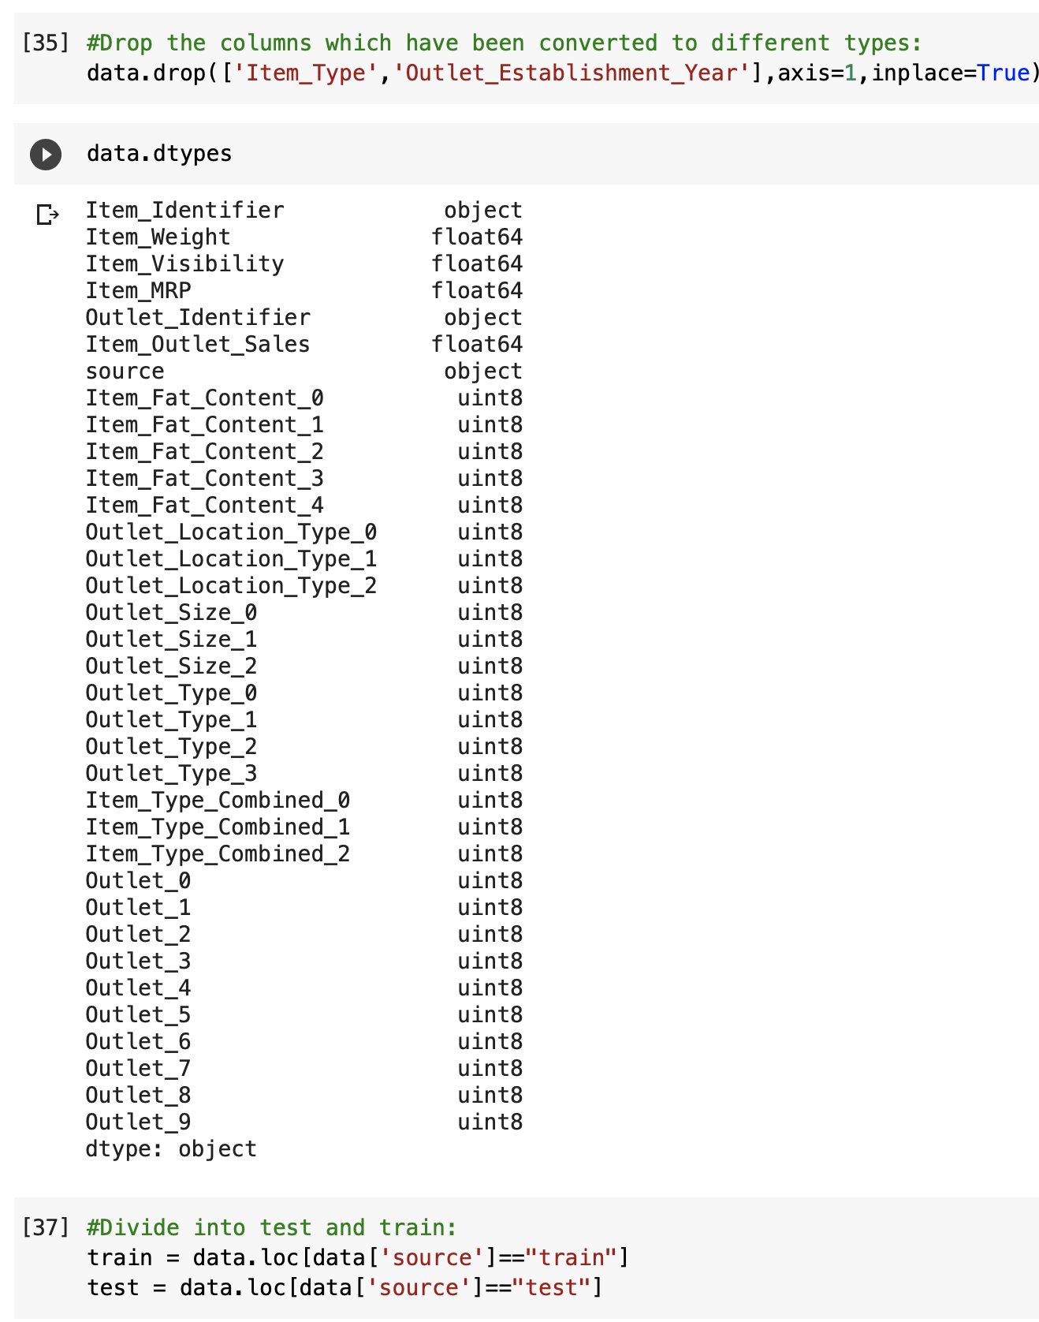
Data Splitting & Exporting

Slide 17
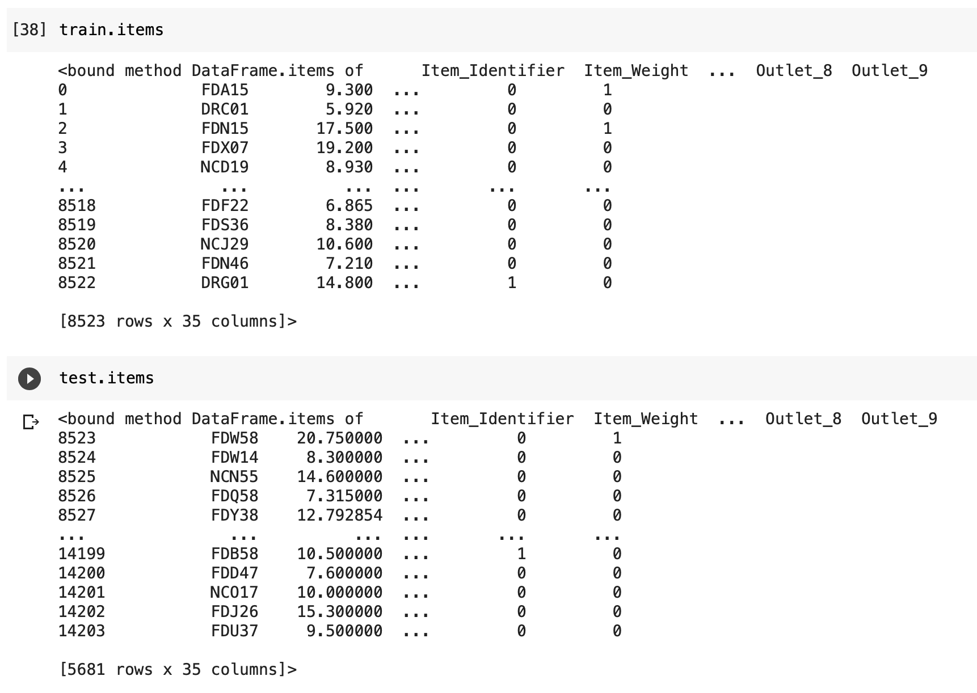
Data Splitting & Exporting

Slide 18
Training Models Used
Linear Regression Model
Random Forest Model
XgBoost Model
Gradient Boosted Decision Tree

Slide 19
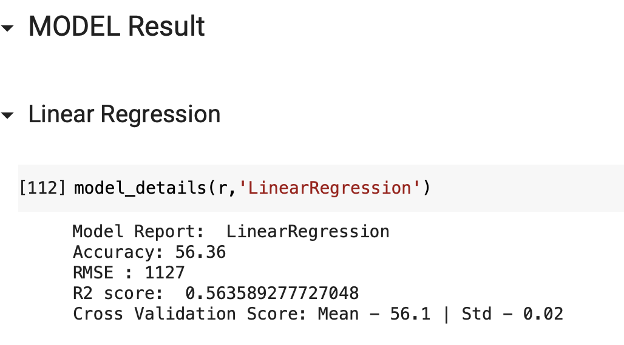
Model Results :

Slide 20
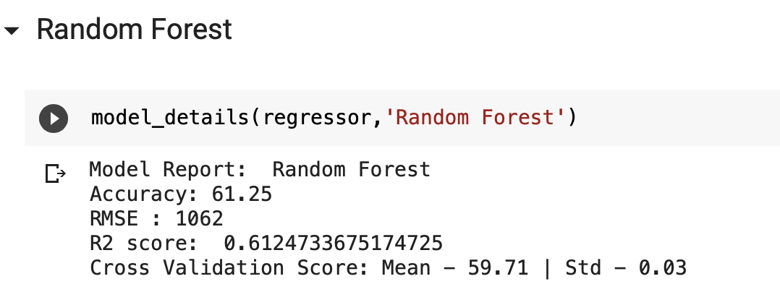
Model Results :

Slide 21
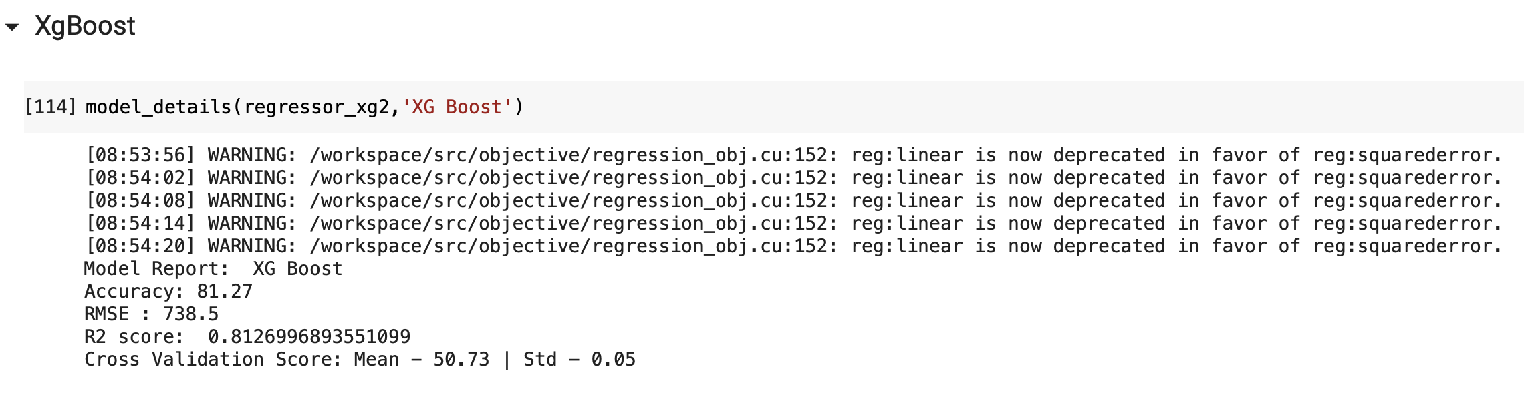
Model Results :

Slide 22
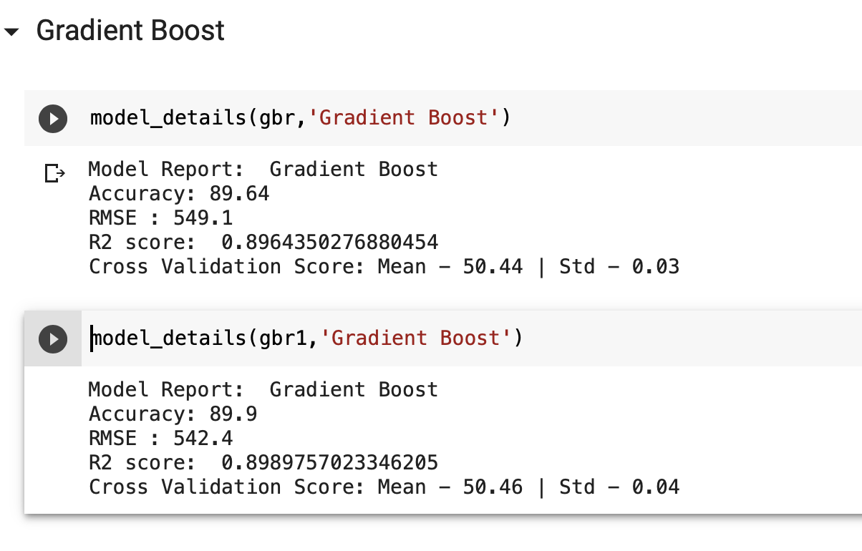
Model Results :

Slide 23
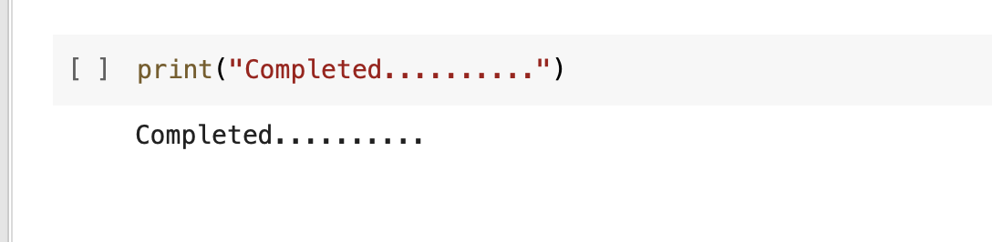
Finally…
Thanks to All!

